Slide 1


Results of the spatial simulation experiment for IO YFT
IATTC team (SS3 areas-as-fleets × VAST)
Haikun Xu, Mark Maunder, and Carolina Minte-Vera
Spatial Simulation Experiment Workshop
Wellington, NZ
March 5, 2023

Slide 2

Outline
Recap of the method and results presented at the webinar
Discussion of what could be done to further improve the estimation model
General discussion regarding good practices for “areas-as-fleets” models

Slide 3
Introduction (SS3 areas-as-fleets × VAST)
The IATTC team fits a single-stock assessment model to the simulated dataset for yellowfin tuna in the Indian Ocean - use SS 3.24 (consistent with the version of the SS data provided by the workshop)
The assessment model ignores all simulated tagging data and uses the “areas-as-fleets” approach to deal with spatially-varying fishery selectivity
The assessment model includes a number of fishery fleets and one survey fleet (a term in SS referring to a fleet that has data (e.g., abundance index and compositions) but takes no catch)
The survey fleet is added to the model to reflect the abundance and length compositions of the whole population. We use VAST to fit separately to cell-level longline CPUE and length composition data simulated for the entire Indian Ocean, generating area-weighted standardized abundance index and associated length compositions for the survey fleet.

Slide 4
Data: fishery fleets
Input sample sizes:
Associated PS and LL: the number of spatial cells sampled
Others: 5
Evaluate the impacts of two dimensions: 1) how to define associated PS fishery fleets and 2) how to weight fishery length compositions on model performance
 | One fishery per gear/set type | Three region-specific fleets (regions 1, 2, and 4) | Three regression-tree fleets
Fishery length comps for associated PS are sample weighted | Model sample-one | Model sample-region | Model sample-tree
Fishery length comps for associated PS are catch weighted | Model catch-one | Model catch-region | Model catch-tree

Slide 5
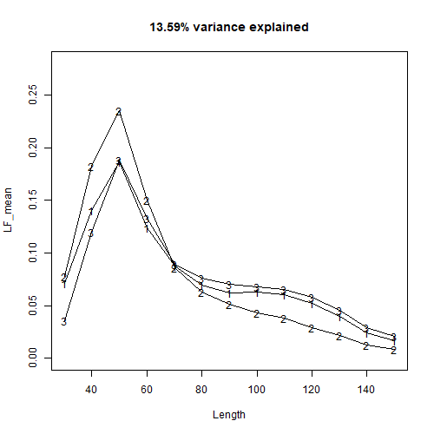
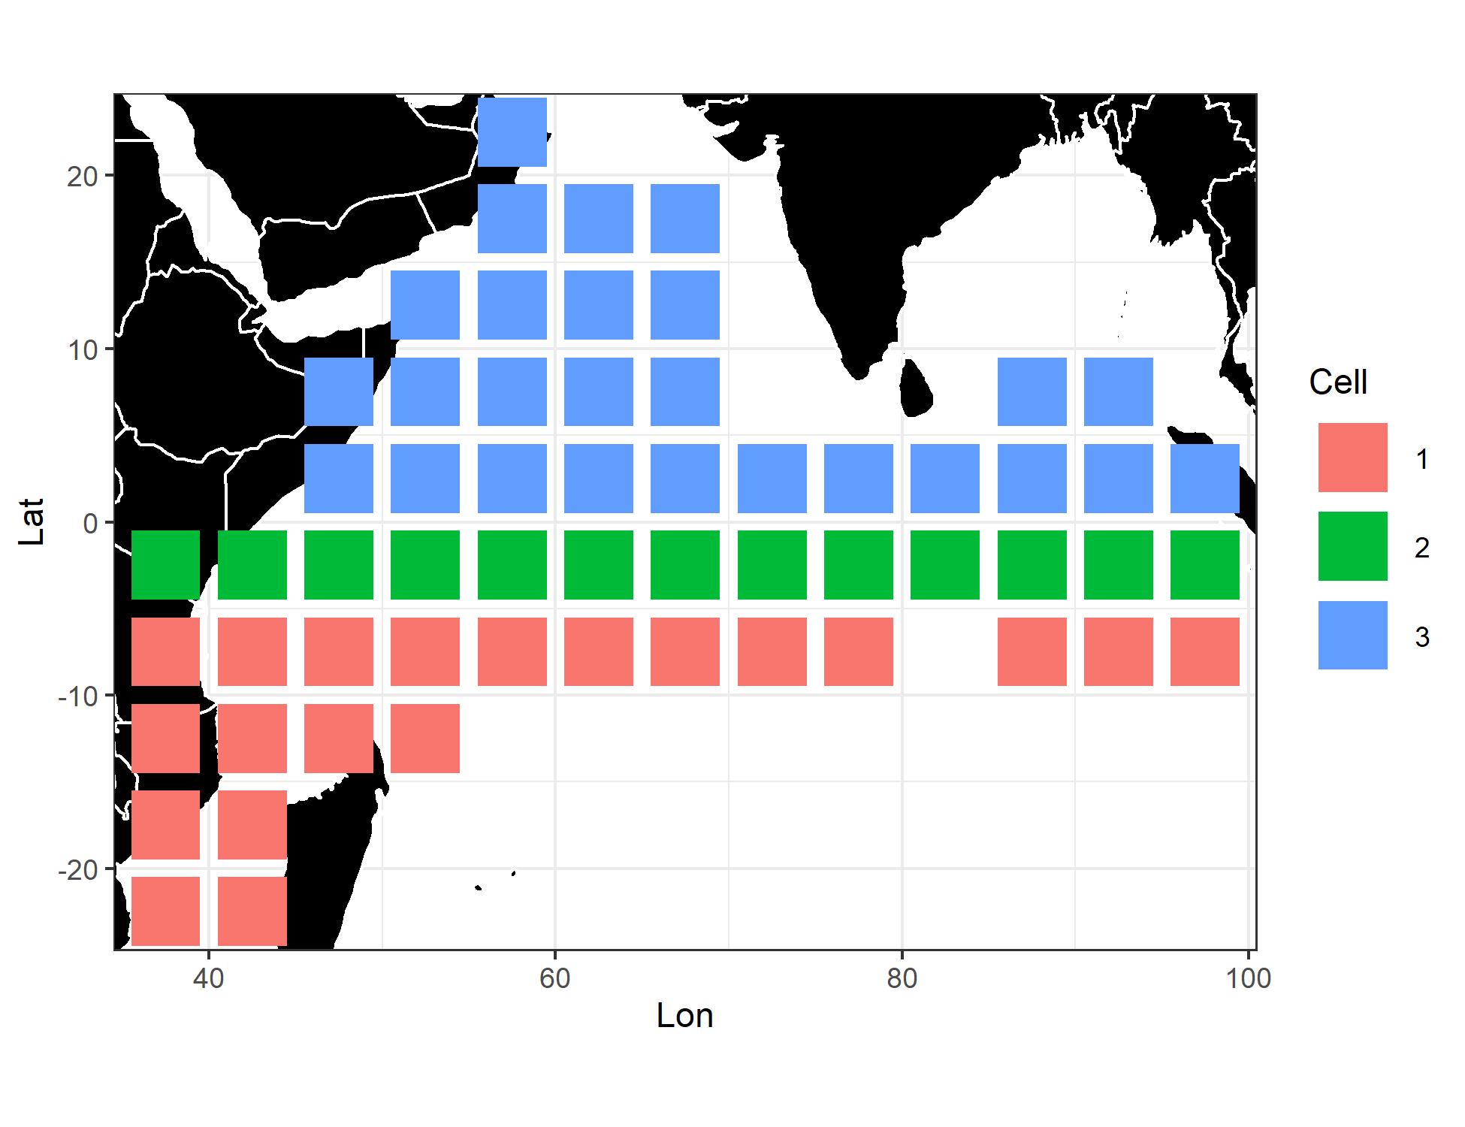
Data: fishery fleets (region-specific vs. regression-tree)
Different selectivity curves for the three associated PS fleets
Default associated PS fishery definition (R1, R2, and R4)
Regression tree-defined associated PS fisheries

Slide 6
Model configurations
All biological parameters are fixed at their true values (steepness, M, and G are confounded and are difficult to estimate within the assessment model)
Recruitment deviations are estimated for every model year and are assumed to sum to zero
Age-specific selectivity is used in order to be consistent with the simulation model
Selectivity is assumed to be logistic for the survey fleet and double-normal (could be asymptotic) for all, including longline, fishery fleets
Lack of composition data for the troll fishery: all three troll fleets share the same selectivity
Initial conditions: the stock is assumed to be harvested from an equilibrium unfished condition

Slide 7
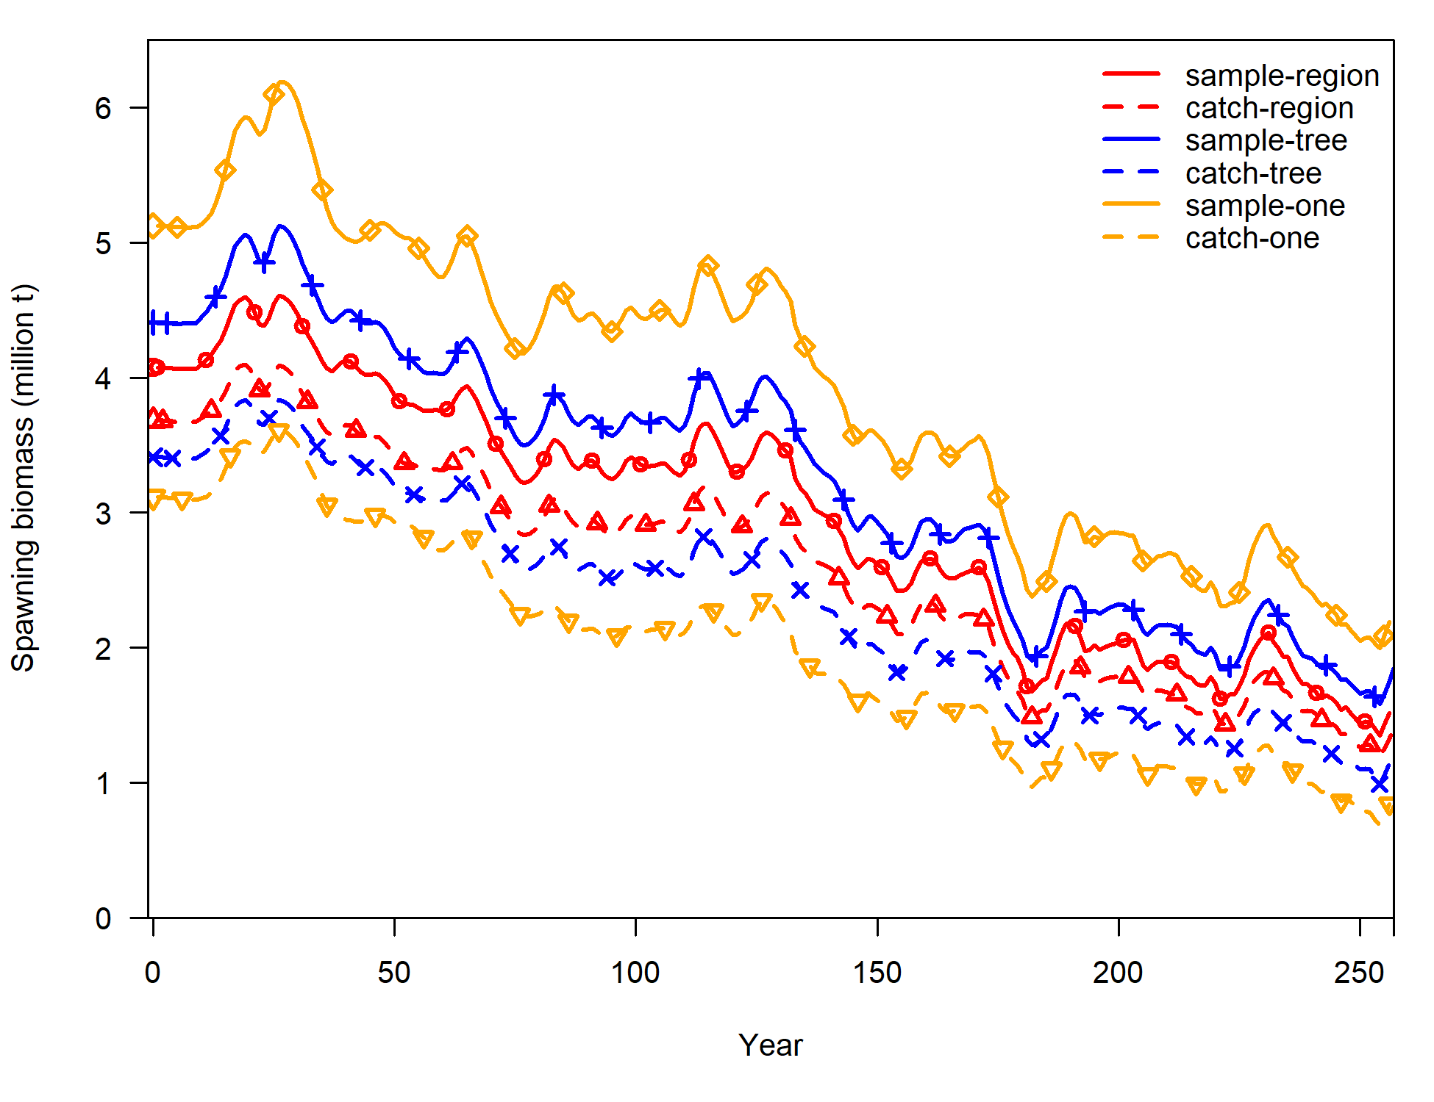
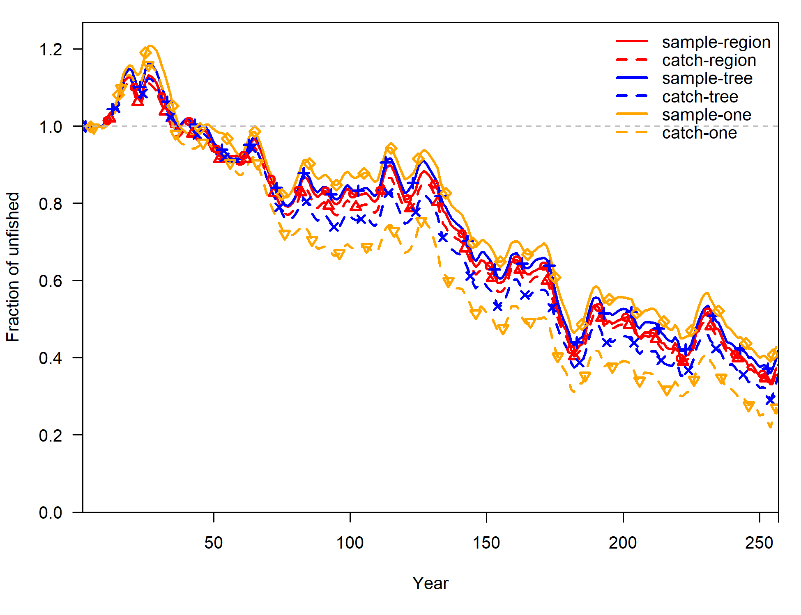
Model results: example replicate (#4)
 | One fishery per gear/set type | Region-specific fisheries | Regression-tree fisheries
Fishery length comps for associated PS: sample weighted | Model sample-one | Model sample-region | Model sample-tree
Fishery length comps for associated PS: catch weighted | Model catch-one | Model catch-region | Model catch-tree

Slide 8
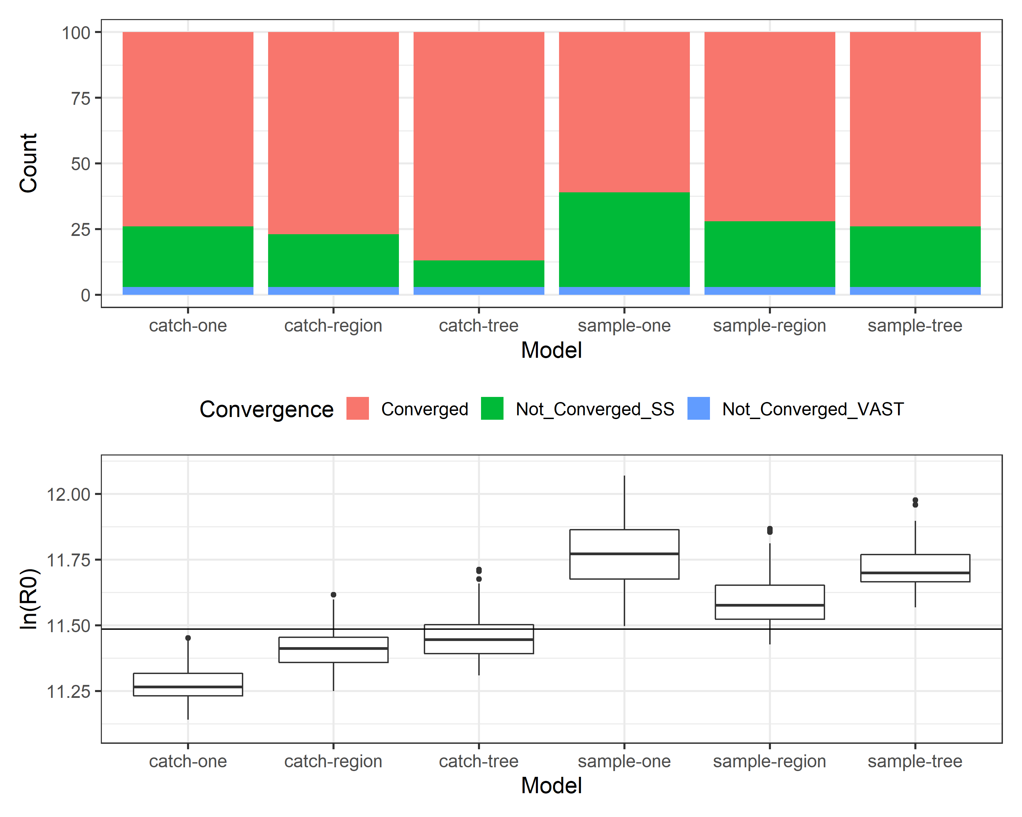
Expand to the 100 replicates
 | One fishery per gear/set type | Region-specific fisheries | Regression-tree fisheries
Fishery length comps for associated PS: sample weighted | Model sample-one | Model sample-region | Model sample-tree
Fishery length comps for associated PS: catch weighted | Model catch-one | Model catch-region | Model catch-tree
We compare the estimate of R0 with its true value to evaluate model performance
True value

Slide 9
Expand to the 100 replicates
 | One fishery per gear/set type | Region-specific fisheries | Regression-tree fisheries
Fishery’s length comps for associated PS: sample weighted | Model sample-one | Model sample-region | Model sample-tree
Fishery’s length comps for associated PS: catch weighted | Model catch-one | Model catch-region | Model catch-tree
Ignoring “areas-as-fleets” results in worst convergence and most biased ln(R0)

Slide 10

Expand to the 100 replicates
 | One fishery per gear/set type | Region-specific fisheries | Regression-tree fisheries
Fishery’s length comps for associated PS: sample weighted | Model sample-one | Model sample-region | Model sample-tree
Fishery’s length comps for associated PS: catch weighted | Model catch-one | Model catch-region | Model catch-tree
Ignoring “areas-as-fleets” results in worst convergence and most biased ln(R0)
In comparison to sample-weighted fishery comps, catch-weighted fishery comps correspond better convergence and less biased ln(R0)

Slide 11
Expand to the 100 replicates
 | One fishery per gear/set type | Region-specific fisheries | Regression-tree fisheries
Fishery’s length comps for associated PS: sample weighted | Model sample-one | Model sample-region | Model sample-tree
Fishery’s length comps for associated PS: catch weighted | Model catch-one | Model catch-region | Model catch-tree
Ignoring “areas-as-fleets” results in worst convergence and most biased ln(R0)
In comparison to sample-weighted fishery comps, catch-weighted fishery comps correspond better convergence and less biased ln(R0)
Given length comps are catch-weighted, regression-tree defined fisheries correspond to better convergence and less biased ln(R0)

Slide 12
Expand to the 100 replicates
 | One fishery per gear/set type | Region-specific fisheries | Regression-tree fisheries
Fishery’s length comps for associated PS: sample weighted | Model sample-one | Model sample-region | Model sample-tree
Fishery’s length comps for associated PS: catch weighted | Model catch-one | Model catch-region | Model catch-tree
Ignoring “areas-as-fleets” results in worst convergence and most biased ln(R0)
In comparison to sample-weighted fishery comps, catch-weighted fishery comps correspond better convergence and less biased ln(R0)
Given length comps are catch-weighted, regression-tree defined fisheries correspond to better convergence and less biased ln(R0)
The best model: “areas-as-fleets”; regression-tree defined fisheries; catch-weighted fishery length comps

Slide 13
Summary of the best model
Data
Use the regression tree algorithm to define associated PS fisheries
Biology
All biological parameters (steepness, M, and G) are fixed at their true values
“Survey” fleet
VAST provides one standardized abundance index with time-varying CV – the index is area-weighted across the IO for the entire population
VAST provides standardized length frequencies for the abundance index – CPUE-raised length frequencies are area-weighted across the IO so the survey selectivity represents contact selectivity (assumed to be logistic)

Slide 14
Summary of the best model
Fishery fleets
Length frequencies for associated PS fisheries are spatially weighted by catch in numbers
Input sample size is time-varying: the number of 5*5 grids sampled
All fishery selectivity curves are double-normal (three of the four longline fishery selectivity curves are estimated to be asymptotic)
Data weighting
Effective sample size is estimated based on the Francis method
Model
Spatially-implicit areas-as-fleets approach

Slide 15
Summary of the best model
Diagnostics based on runs test, fit to overall length comps, ASPM, retrospective pattern suggest the best model performs relatively well
The estimate of R0 from this AAF model is quite accurate
The model can be further improved in a few ways

Slide 16
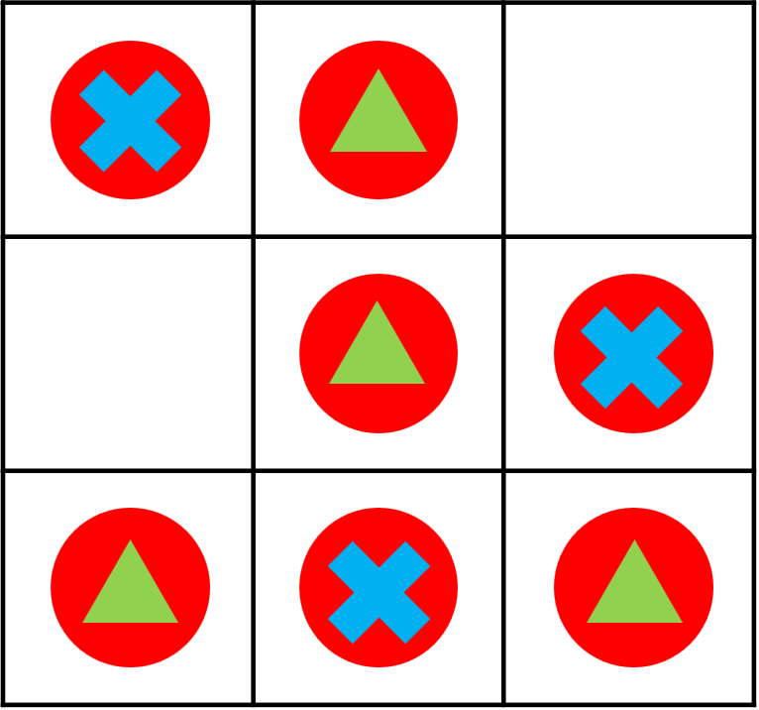
What could be done to further improve this model?
Standardize fishery length frequencies
Fishery-dependent comps are sparse in space and cover a small portion of fishery catch
Catch-raised fishery comps may not be representative of the total removal
Need to use a length-specific spatiotemporal model to impute length frequency for unsampled “holes” (grids with positive catches but no length comps)
In this way, fishery comps can be raised to total catch
circle: has positive catch
cross: has length comps
triangle: no length comps

Slide 17
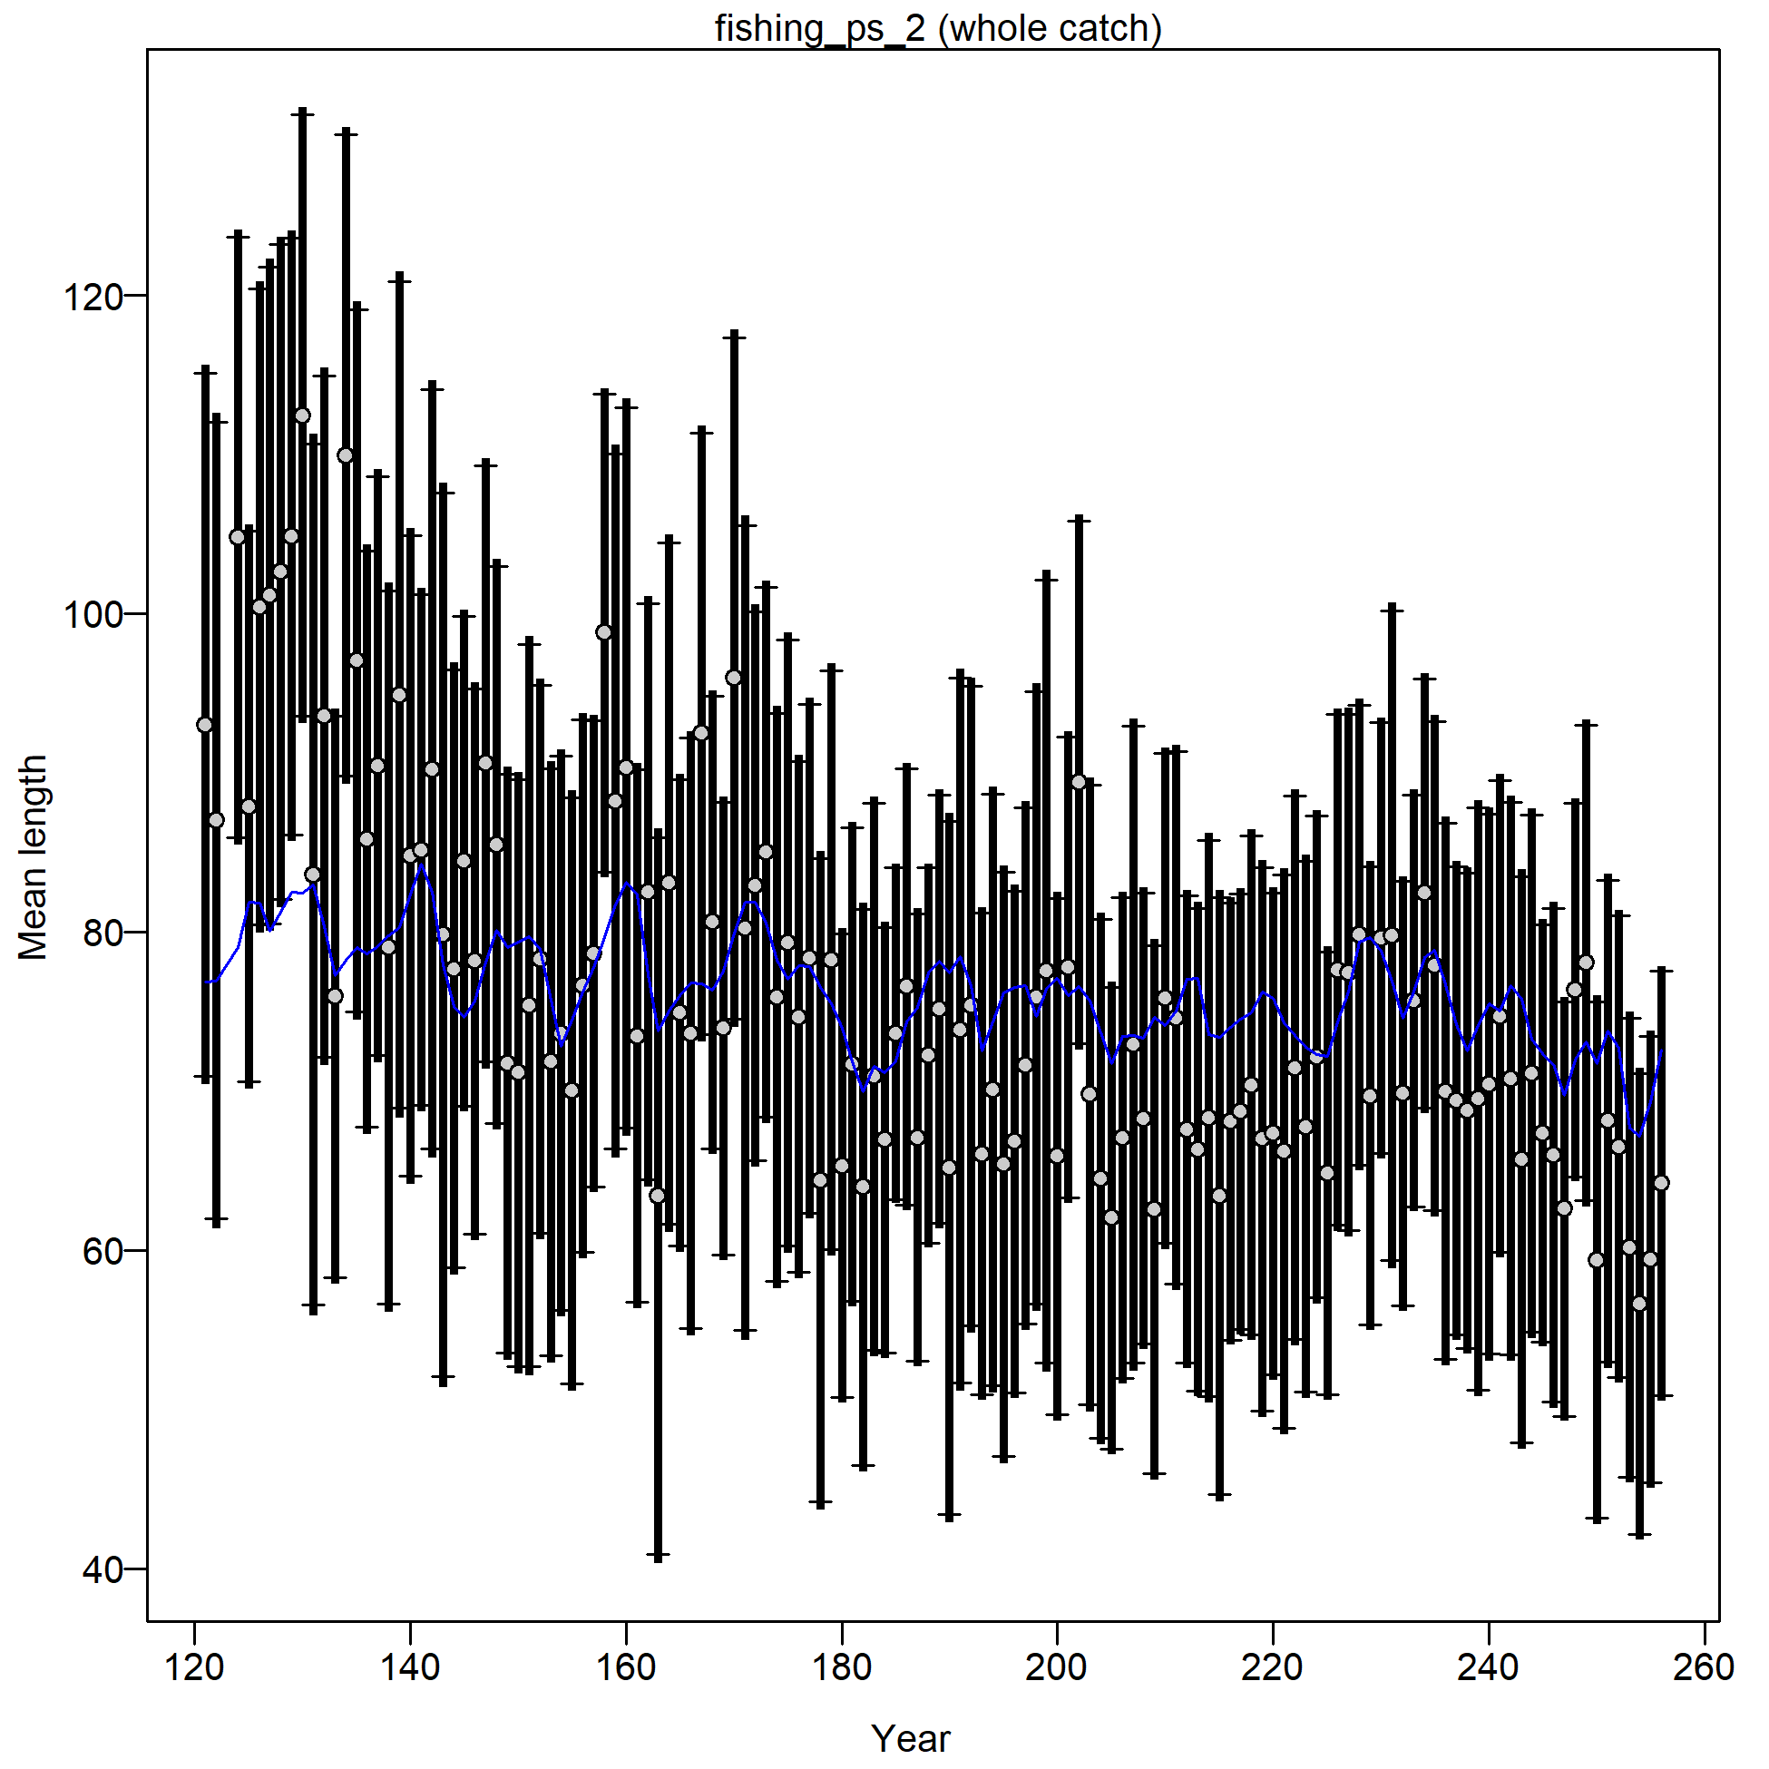
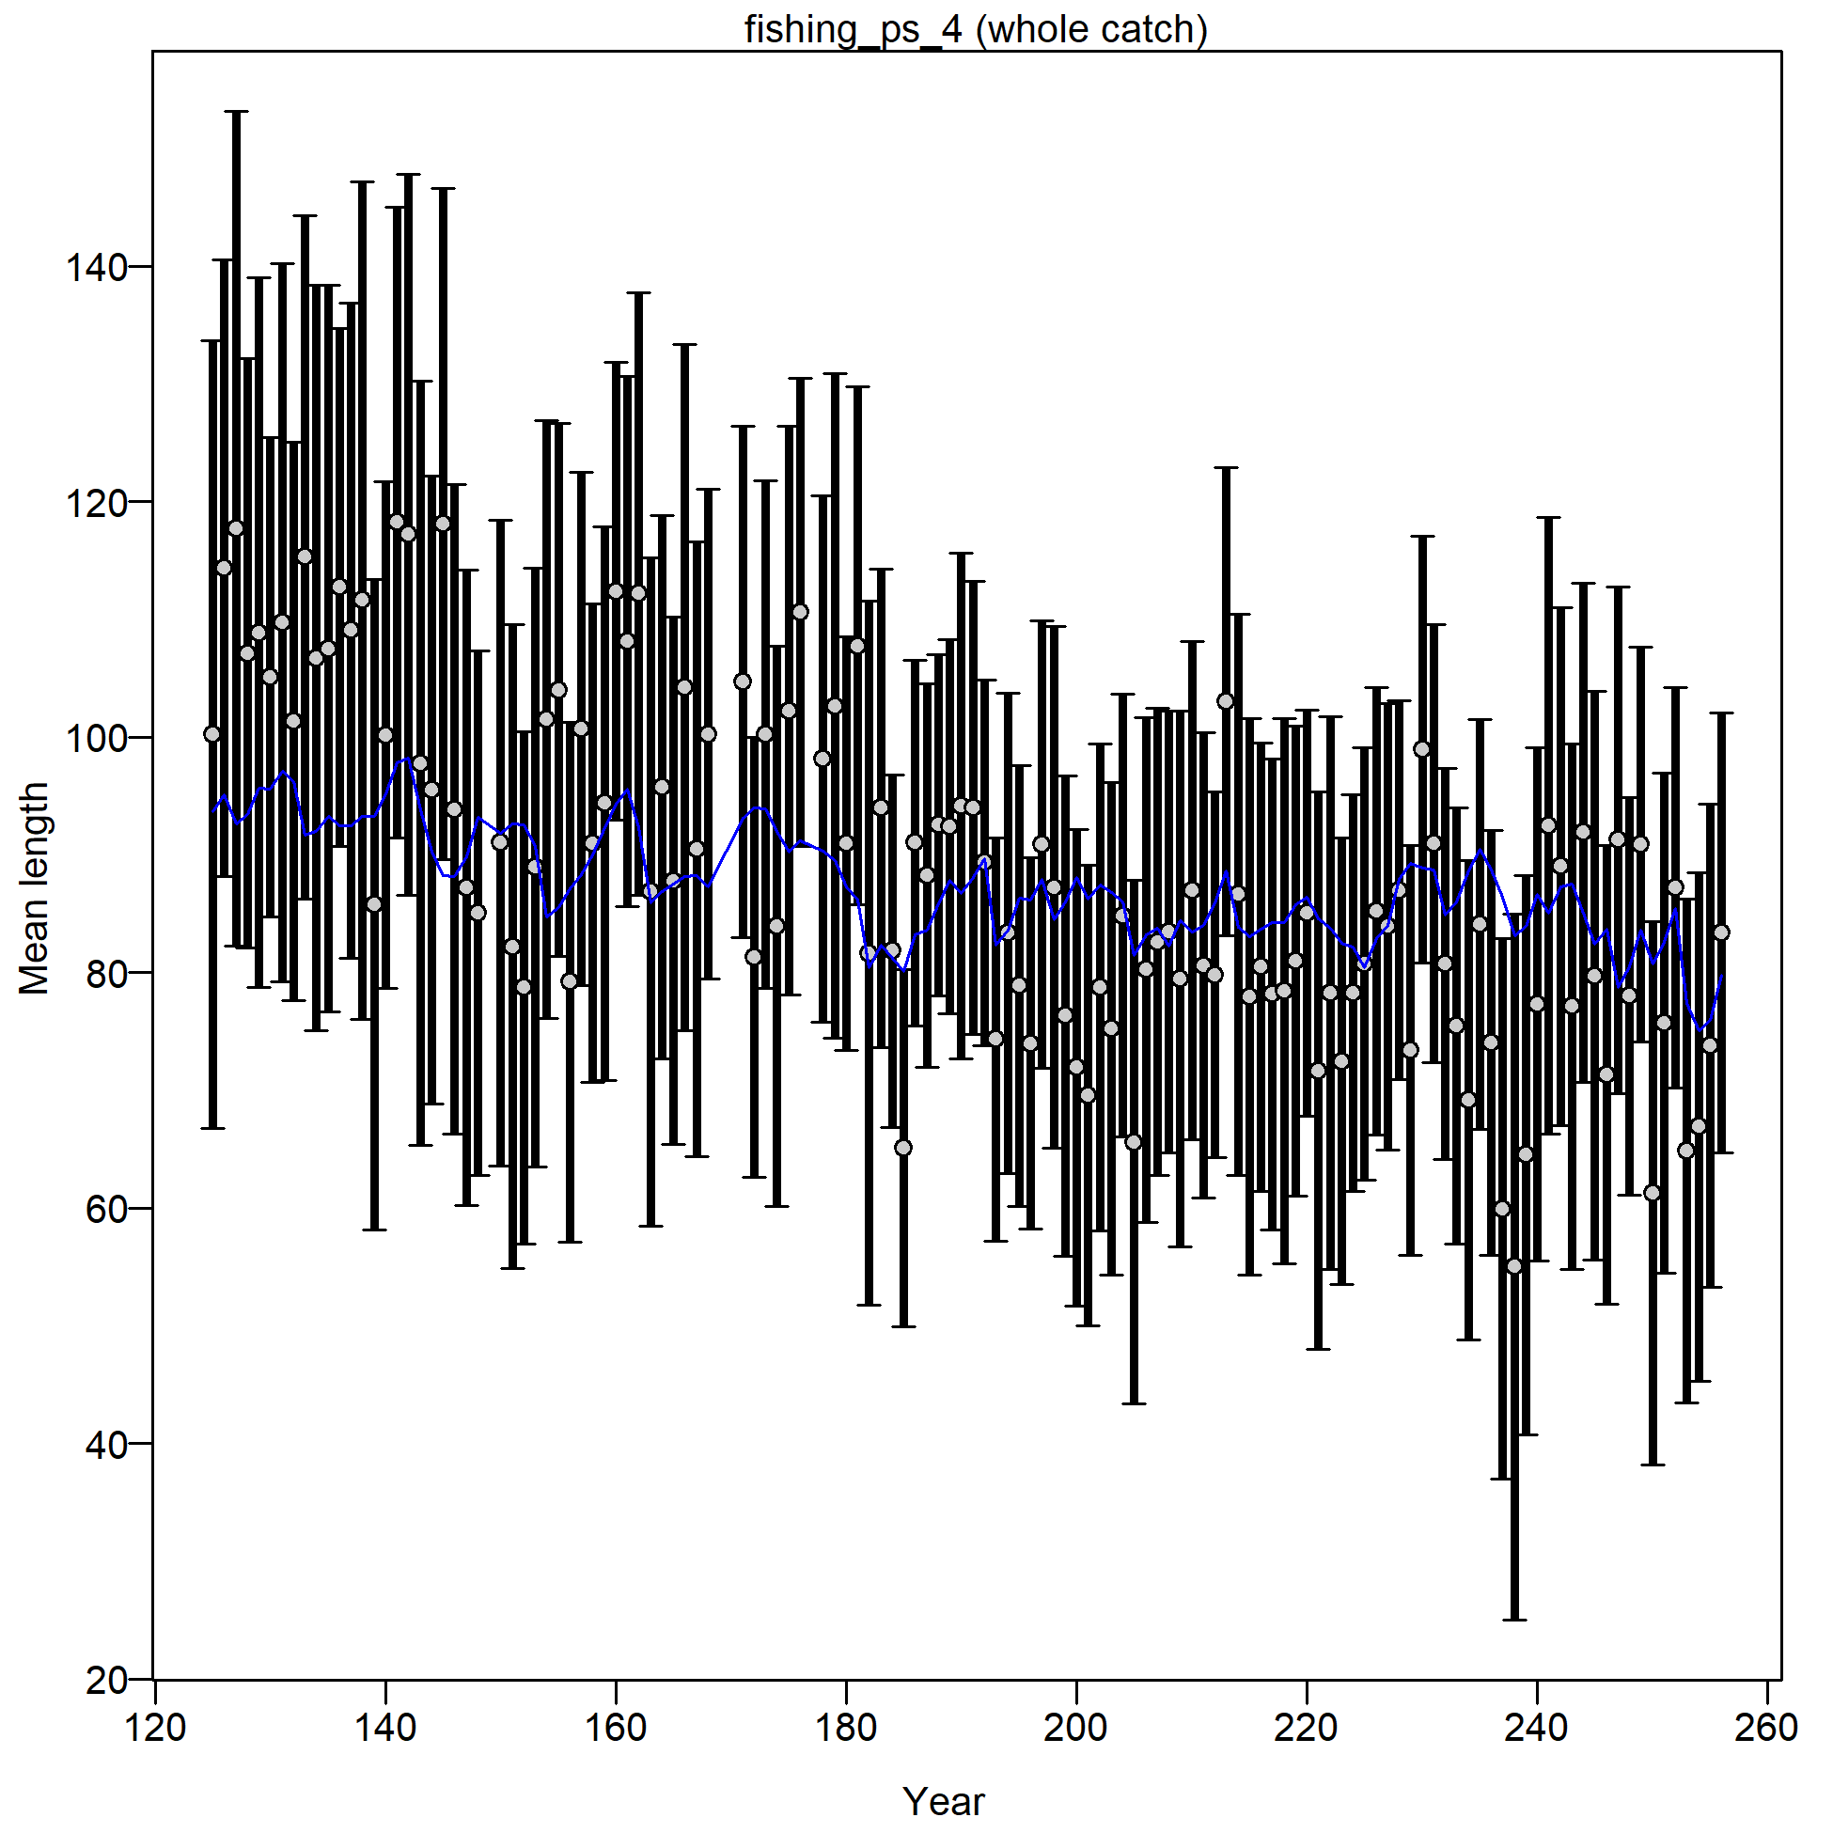
What could be done to further improve this model?
Deal with time-varying fishery selectivity curves
Regression-tree defined associated PS fisheries
Cell 2
Cell 3

Slide 18
What can cause time-varying fishery selectivity?
Implicit assumption for areas-as-fleets: the stock is homogeneously distributed across its range, and any differences in age or length compositions are due to contact selectivity, even if the “true” contact selectivity may not differ spatially but the proportion of the population by length differs among areas (Hurtado-Ferro et al. 2014)

Slide 19
What can cause time-varying fishery selectivity?
For a given location, fishery selectivity is affected by contact selectivity and availability
Within a fishery area, however, spatial heterogeneity in availability still exists
Fishery length comps are computed by spatially raising length frequencies to catch in numbers
Fishery selectivity is therefore affected by contact selectivity, availability, and fishing intensity
For this simulation with constant contact selectivity, time-varying fishery selectivity is caused by time-varying availability or/and fishing intensity

Slide 20
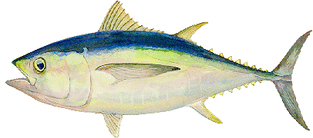
Time-varying availability
Ideal world (t)
Ideal world (t+1)

Slide 21
Time-varying availability
Ideal world (t)
Real world (t)
Ideal world (t+1)
Real world (t +1)

Slide 22
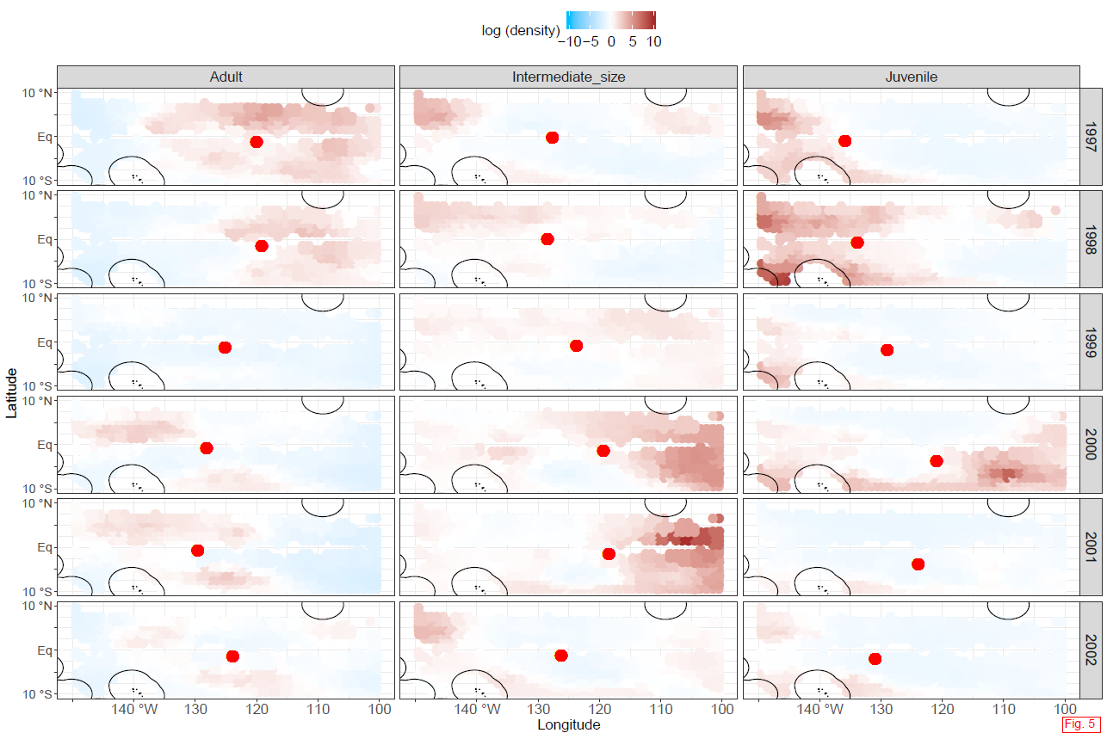

Time-varying availability

Slide 23
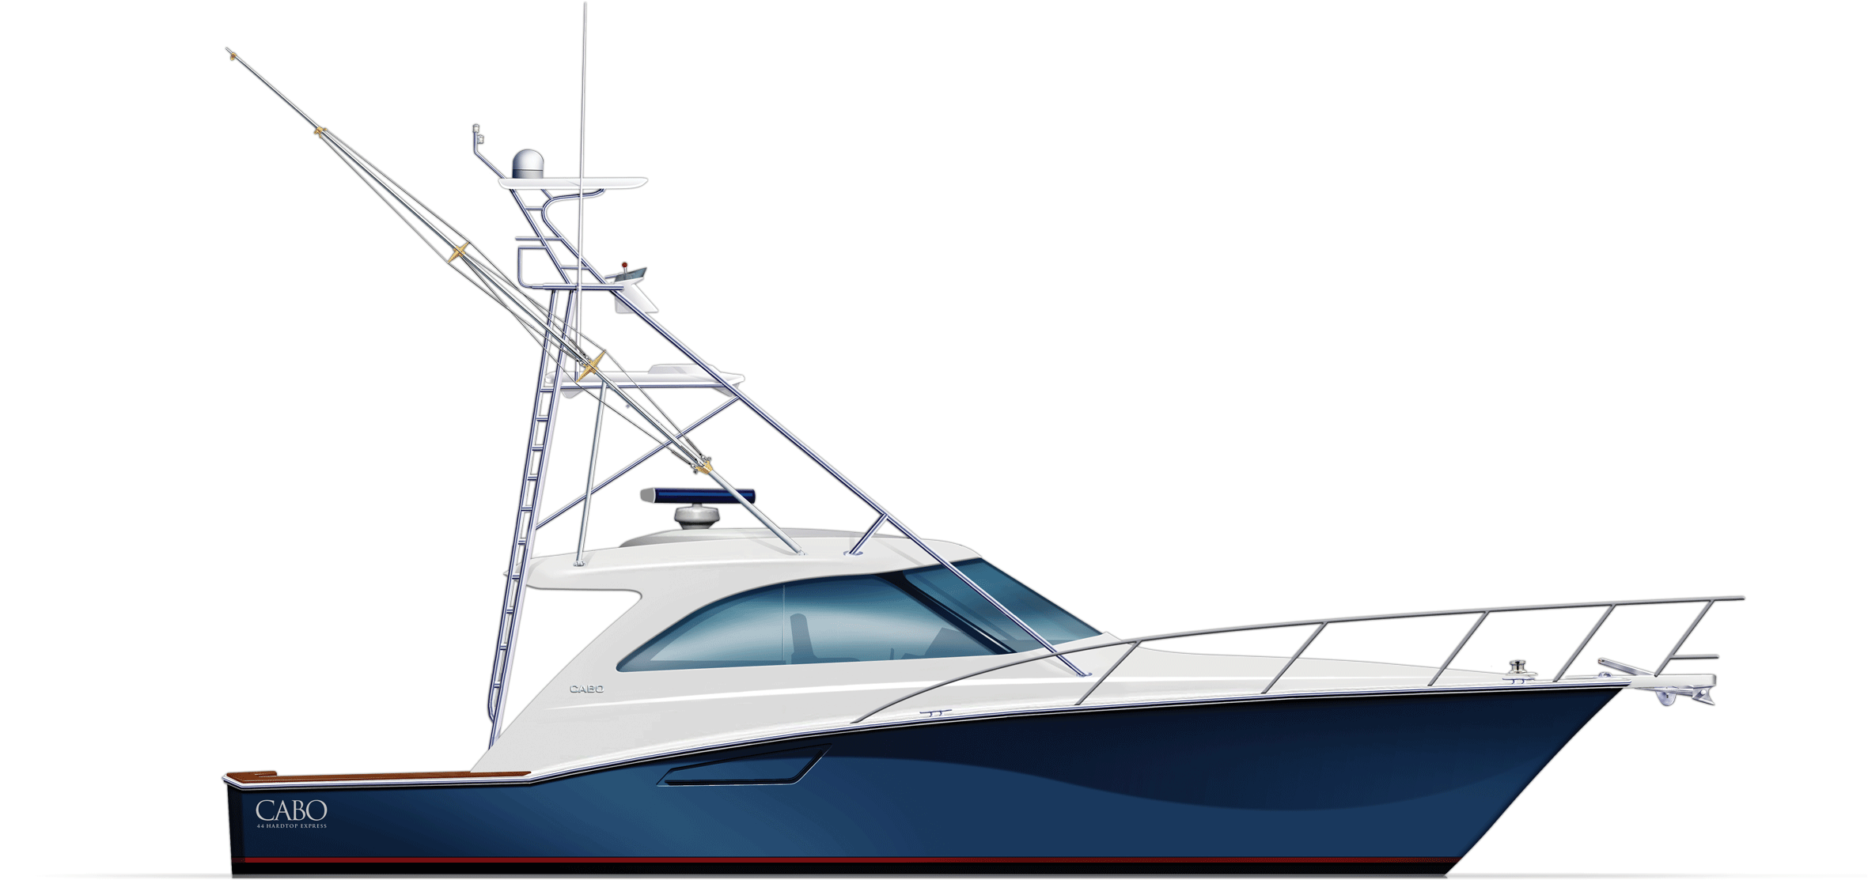
Time-varying fishery intensity
Ideal world (t)
Ideal world (t+1)

Slide 24
Time-varying fishery intensity
Ideal world (t)
Real world (t)
Ideal world (t+1)
Real world (t +1)

Slide 25
What could be done to further improve this model?
Deal with time-varying fishery selectivity curves
Regression-tree defined associated PS fisheries
Cell 2
Cell 3

Slide 26
What could be done to further improve this model?
Deal with time-varying fishery selectivity curves
Regression-tree defined associated PS fisheries
If time-varying selectivity is due only to time-varying fishing intensity (e.g., fishery expansion/contraction), splitting the area into multiple smaller areas can reduce within-area spatial heterogeneity in availability and reduce the residual pattern in mean length
If time-varying selectivity is due only to between-area movements (e.g., climate change or competition-driven directional change in movement rates), adding time blocks to associated PS selectivity can reduce model mis-specification

Slide 27
What could be done to further improve this model?
Split area 2/3 into two areas
If the residual pattern in mean length is still strong, consider two time blocks to selectivity (or time-varying selectivity but it is computationally expensive)
Regression-tree defined associated PS fisheries
Cell 2
Cell 3

Slide 28
How to select areas for fisheries?
Punt 2019: The aim when selecting areas is that animals are distributed homogenously across each area such that the age-/size-composition of the catch is independent of where fishing or surveys take place within the area.
We recommend using the regression tree algorithm, which provides a quantitative approach to divide comp data into more homogeneous subgroups by finding the greatest decrease in the heterogeneity of comp data.
Future research:
Develop methods to cluster irregular continuous spatial areas
Remove the recruitment effect before applying the regression tree to LF
Dynamic specifications

Slide 29
How to decide the number of areas?
There should be a “sweet spot” in the number of areas for a gear
The number of areas is not necessarily the same for different gears and set types
The gear or set-type with high catch, abundance length comp data, and wide spatial distribution should have more areas
Large spatial heterogeneity within an area
Low sample size leads to noisy comp data
Residual in mean length
Small number/
Large area
large number/
Small area

Slide 30
What could be done to further improve this model?
We should down-weighting fishery length comps:
Fishery comps are affected by the spatial distribution of fish and fishing effort. In principle, a spatial shift in fishing effort or availability should not impact the estimation of absolute and relative abundance, which according to the R0 likelihood profile is strongly influenced by fishery length comps.
Survey abundance index and associated length comps are standardized, so the impact of time-varying availability and fishing effort is minimized and survey selectivity is approximately time-invariant. Thus, survey comps are more reliable than fishery comps in informing recruitment and depletion.
Survey comps are based on the same raw comp data as fishery comps, so down-weighting fishery comps does not lose info provided by raw comp data.
The main role of fishery length comps is to inform the model how to remove fish by size.

Slide 31
When to use time-varying selectivity for fisheries?
2D (age/length and time) autocorrelated selectivity is available in SS
Induce too many new parameters for just one fishery
Using time-varying selectivity improves model performance only when comp data are very informative (Xu et al. 2019 CJFAS)
Care should be taken when using time-varying selectivity: the Francis method can greatly over-estimates the effective sample size when selectivity is time-varying (Xu et al. 2020 CJFAS)

Slide 32
My thoughts on dealing with time-varying selectivity
Important fisheries: high catch and abundant comp data
Include enough areas to reduce spatial heterogeneity within an area
If the residual pattern in ML not obvious: constant selectivity + Francis weight
If the residual pattern in ML is obvious with a few positive/negative blocks: time-varying selectivity using blocks + <Francis weight
If the residual pattern in ML is obvious without clear cuts: constant selectivity + <<Francis weight (the Francis approach does not consider residual’s temporal pattern)
Unimportant fisheries: low catch and sparse comp data
Don’t include many areas
If the residual pattern in ML is not obvious: constant selectivity + <Francis weight
If the residual pattern in ML is obvious: constant selectivity + <<Francis weight

Slide 33
When is the areas-as-fleets approach adequate?
Simulations for Pacific sardine by Hurtado-Ferro et al. 2014 suggest that the performance of the AAF model can be greatly reduced when time-varying movement exists.
Punt et al. 2016: The bias in estimates of spawning stock biomass associated with AAF increases in the presence of closed areas. The performance of AAF models depends on the interactions among spatial variation in growth, in exploitation rate, and in knowledge of the spatial areas over which growth and exploitation rate are homogeneous.
Lee et al. 2017 conducted a simulation study for Pacific bluefin, showing that time-varying age-based selectivity can be used in the AAF model to implicitly account for time-varying movement.

Slide 34
Final thoughts on good practices for AAF
The AAF approach cannot explicitly account for time-varying spatial pattern in availability, so the model should rely less on the data in which time-varying availability signal exists (fishery comps) and more on the data in which time-varying availability signal is greatly reduced (area-weighted survey index and comps)
Need to test the recommendation above in the next phase of this simulation experiment when we have the time and computation resource to compare more model specifications.

Slide 35


Questions?

